Slide 1
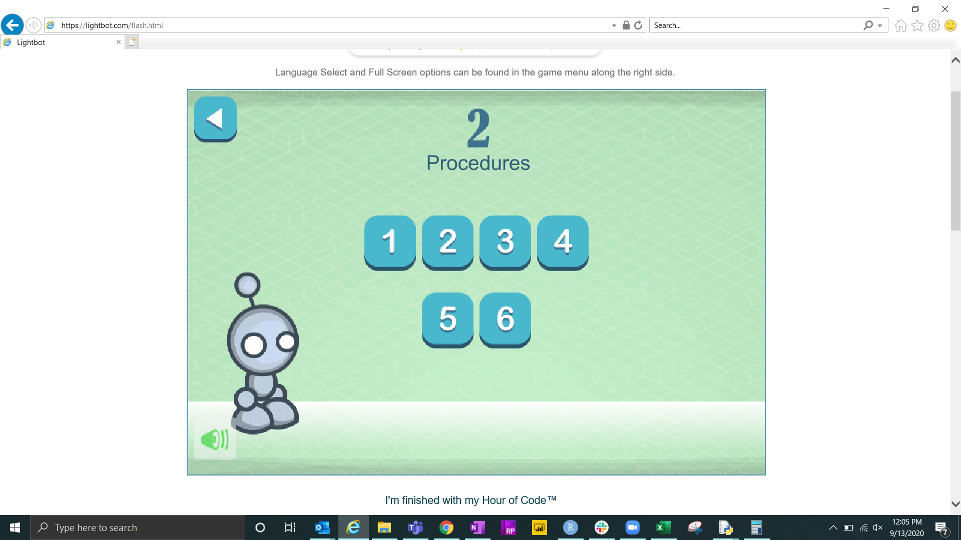
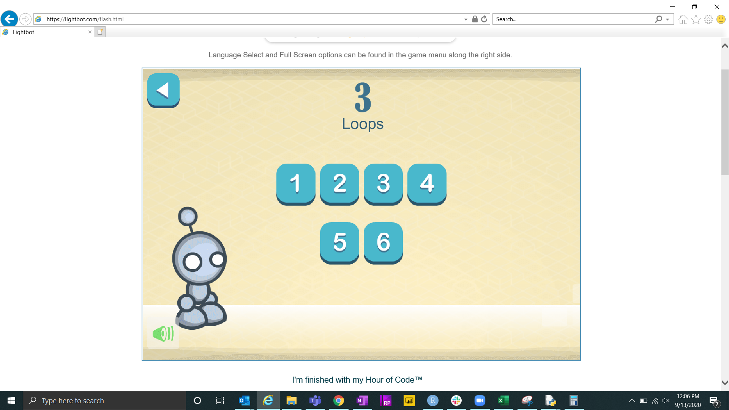
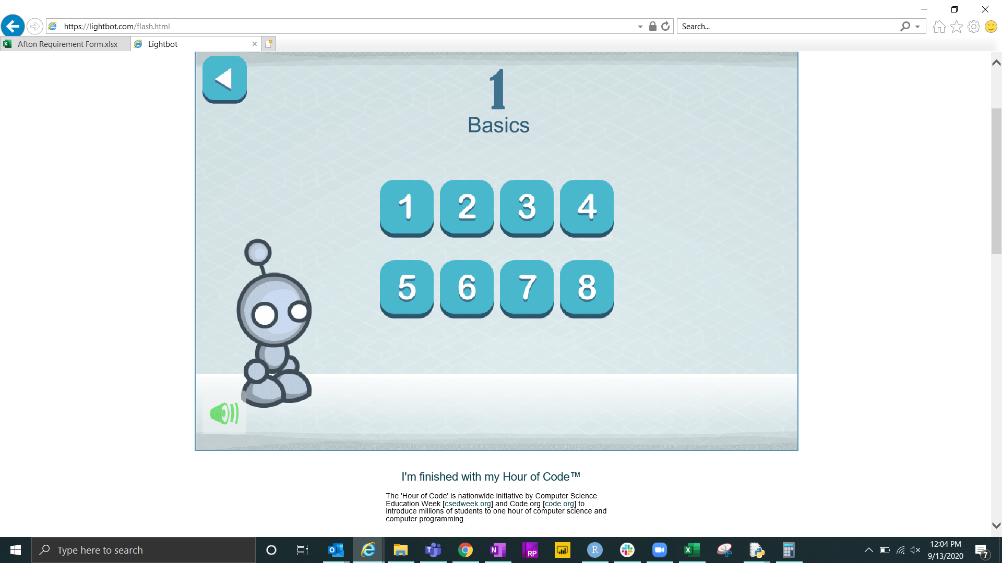

Slide 2


Slide 3
Start: Current month ends
Initialize:
charity_tax = 0.10
tax_rate = 0.326
Input:
gross_check
net_check = gross_check - (gross_check * tax_rate)
donation = net_check * charity_tax
Output:
donation
Done

Slide 4
Start: Current month ends
Start: Current month ends
George earns a paycheck (Gross)
Initialize:
charity_tax = 0.10
tax_rate = 0.326
George’s earnings are taxed 32.6% (tax)
Input:
gross_check
George receives direct deposit (Net)
George’s donation (Donation) is 10% (Charity Tax) of his Net
net_check = gross_check - (gross_check * tax_rate)
donation = net_check * charity_tax
Output:
donation
Done

